Slide 1


tooling for
bullet proof
software
Fabrice Derepas
Co-founder
CEO TrustInSoft
@fderepas
September 2020

Slide 2
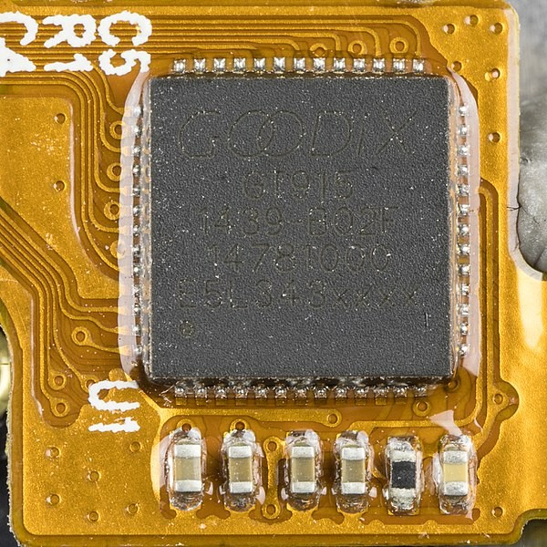
Wiko Rainbow 4G - Goodix GT915 - Large-screen phone 5:00 capacitive touch chip

Slide 4
Journey to bug free software
Test Activities
Bug free
Expected outcome
Full top down requirement refinement
Full mathematical guarantee for safety and security
Level 5
Some security or safety properties are specified
Level 4
Ensure and enforce security properties
Unit and integration test process
Level 3
Guarantee the absence of standard defects
Some software tests exist and are replayed regularly
Level 2
More defects found by test team
Developers perform tests on their own
Level 1
Developers find existing bugs earlier
at risk

Slide 5
Analysis result
We state the total immunity of the GT9xx driver to the set of security weaknesses enumerated below when used according to the model and perimeter of this analysis.
CWE-119 Improper Restriction of Operations within the Bounds of a Memory Buffer
CWE-120 Buffer Copy without Checking Size of Input (‘Classic Buffer Overflow’)
CWE-121 Stack-based Buffer Overflow
CWE-122 Heap-based Buffer Overflow
CWE-123 Write-what-where Condition
CWE-124 Buffer Underwrite (‘Buffer Underflow’)
CWE-125 Out-of-bounds Read
CWE-127 Buffer Under-read
. CWE-369 Divide By Zero
CWE-415 Double Free
CWE-416 Use After Free
CWE-457 Use of Uninitialized Variable
CWE-476 NULL Pointer Dereference
CWE-562 Return of Stack Variable Address
CWE-690 Unchecked Return Value to NULL Pointer Dereference

Slide 6

toy example

Slide 7
Compute 2^4 in a virtual machine
#define ARRAY_SIZE 10000
unsigned char mem[ARRAY_SIZE] =
{80, 7, 5, 5, 3, 5, 3, 5, 4, 11, 2};
#define NEXT \
if (pos<ARRAY_SIZE-1) ++pos; break
int main() {
unsigned int A=0, B=0, pos=0;
while (1) {
switch (mem[pos] & 7) {
// add
case 0: A+=mem[pos]>>3; NEXT;
// subtract
case 1: A-=mem[pos]>>3; NEXT;
// load
case 2: A=mem[B]; NEXT;
// store
case 3: if (B<ARRAY_SIZE) mem[B]=A; NEXT;
// exit
case 4: return A;
// load and add
case 5: if (B<ARRAY_SIZE) A=A+mem[B]; NEXT;
// goto A
case 6: if (A<ARRAY_SIZE) pos=A; break;
// swap A and B
case 7: {int tmp=B; B=A; A=tmp;} NEXT;
}}}

Slide 8
Let’s run this code
$ clang vm.c && ./a.out
$ echo $?
16

Slide 9
Compute 2^4 in a virtual machine
#define ARRAY_SIZE 10000
unsigned char mem[ARRAY_SIZE] =
{80, 7, 5, 5, 3, 5, 3, 5, 4, 11, 2};
#define NEXT \
if (pos<ARRAY_SIZE-1) ++pos; break
int main() {
unsigned int A=0, B=0, pos=0;
while (1) {
switch (mem[pos] & 7) {
// add
case 0: A+=mem[pos]>>3; NEXT;
// subtract
case 1: A-=mem[pos]>>3; NEXT;
// load
case 2: A=mem[B]; NEXT;
// store
case 3: if (B<ARRAY_SIZE) mem[B]=A; NEXT;
// exit
case 4: return A;
// load and add
case 5: if (B<ARRAY_SIZE) A=A+mem[B]; NEXT;
// goto A
case 6: if (A<ARRAY_SIZE) pos=A; break;
// swap A and B
case 7: {int tmp=B; B=A; A=tmp;} NEXT;
}}}

Slide 10
256^{10,000}
tests
256^{10,000} is a number with 24,000 digits

Slide 11
solution
#include <tis_builtin.h>
#define ARRAY_SIZE 10000
unsigned char mem[ARRAY_SIZE] =
{80, 7, 5, 5, 3, 5, 3, 5, 4, 11, 2};
#define NEXT \
if (pos<ARRAY_SIZE-1) ++pos; break
int main() {
unsigned int A=0, B=0, pos=0;
tis_make_unkown(mem, ARRAY_SIZE);
while (1) {
switch (mem[pos] & 7) {
// add
case 0: A+=mem[pos]>>3; NEXT;
// subtract
case 1: A-=mem[pos]>>3; NEXT;
// load
case 2: A=mem[B]; NEXT;
// store
case 3: if (B<ARRAY_SIZE) mem[B]=A; NEXT;
// exit
case 4: return A;
// load and add
case 5: if (B<ARRAY_SIZE) A=A+mem[B]; NEXT;
// goto A
case 6: if (A<ARRAY_SIZE) pos=A; break;
// swap A and B
case 7: {int tmp=B; B=A; A=tmp;} NEXT;
}}}

Slide 13
On a standard C/C++ code
C or C++ software
C or C++ software
LibC
STL
Provided by TrustInSoft
LibC
STL
OS
execution
verification

Slide 14
On a module of the linux kernel
Kernel Module Source Code
Kernel Module Source Code
Linux Kernel
Skeleton provided by TrustInSoft
Mutex
Input Drv
Mutex
Input Drv
Device
GPIO
Device
GPIO
IRQ
I2C
IRQ
I2C
Mem Mngt
Time
Mem Mngt
Time
Device tree
Kernel
Device tree
Kernel
execution
verification

Slide 16
The code
The source code used for the analysis is taken from this repository:
https://source.codeaurora.org/quic/la/kernel/msm-3.18/tree/drivers/input/touchscreen/gt9xx?h=LA.HB.1.1.1.c2.
The commit used for the analysis is f7d281d16eff5031b39c41e6af6c527ecec31385.
The data-sheet used to model a GT915 driver is: http://www.datasheet-pdf.com/PDF/GT915-Datasheet-GOODIX-945606

Slide 17
Perimeter (1/2)
To perform an analysis we need to define a main function and stubs. There are two kind of stubs:
The stubs needed to simulate the Linux Kernel APIs
The stubs needed to simulate the behavior of the Hardware
At the Kernel level no parallelism is simulated, i.e. the Kernel is supposed not to be running in a SMP system.
The interrupt handlers are called sequentially after the initialization of the driver.
No verification is done to check if the Linux Kernel APIs are called properly by the driver.

Slide 18
Perimeter (2/2)
The Kernel simulation is very coarse.
At the hardware level, the simulation is based on the GT915 data-sheet.
The testing driver is implemented in function main.
It calls the initialization function of the driver
It forces the probing of the hardware
Perimeter 1 : we call infinitely the IRQ handler -> no UB
Perimeter 2 : write / read proc file -> UB
The behavior of the driver is very dependent on the Linux Device Tree. A fragment of this Device Tree
is defined for the analysis.

Slide 19
Configuration
CPP_EXTRA=(
-D__CHECKER__
-nostdinc
-I./arch/x86/include
-Iarch/x86/include/generated
-Iinclude
-I./arch/x86/include/uapi
-Iarch/x86/include/generated/uapi
-I./include/uapi
-Iinclude/generated/uapi
-include ./include/linux/kconfig.h
-D__KERNEL__
-m64
-DCONFIG_AS_CFI=1
-DCONFIG_AS_CFI_SIGNAL_FRAME=1
-DCONFIG_AS_CFI_SECTIONS=1
-DCONFIG_AS_FXSAVEQ=1
-DCONFIG_AS_CRC32=1
-DCONFIG_AS_AVX=1
-DCONFIG_AS_AVX2=1
”’-DKBUILD_STR(s)=#s’”
”’-DKBUILD_BASENAME=KBUILD_STR(gt9xx)’”
”’-DKBUILD_MODNAME=KBUILD_STR(gt9xx)’”
)

Slide 21
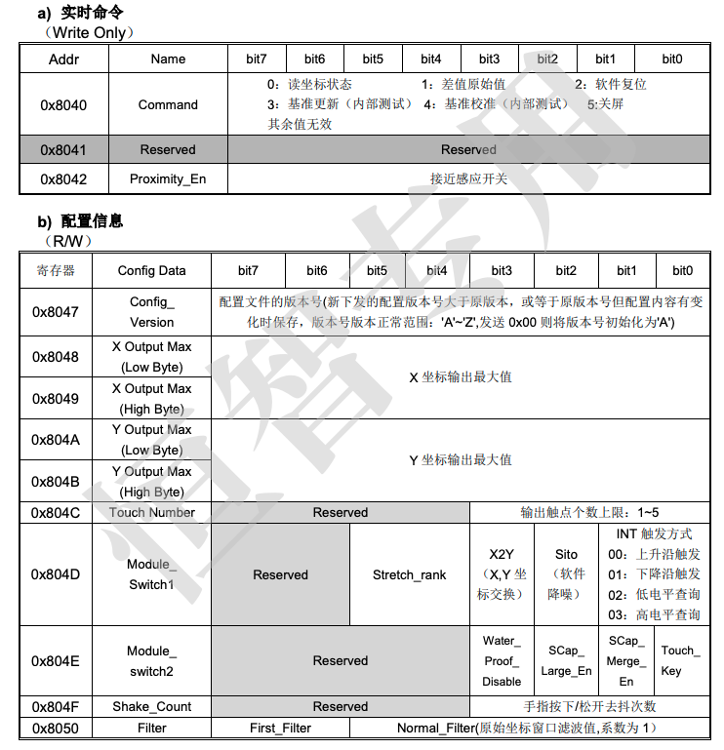
http://www.datasheet-pdf.com/PDF/GT915-Datasheet-GOODIX-945606

Slide 22
Hardware Modeling
Hardware simulates:
A fixed configuration
Any user events on the device
The GUP_REG_FW_MSG (0x41E4) register is ignored because no documentation about it was found.
Only one 16 bits register defines the state of the hardware in the analysis model.
Hardware contains the address of the hardware register that needs to be read when an I2C read is requested.
Hardware is written whenever the I2C bus is sending a write command containing at least 2 bytes.

Slide 23
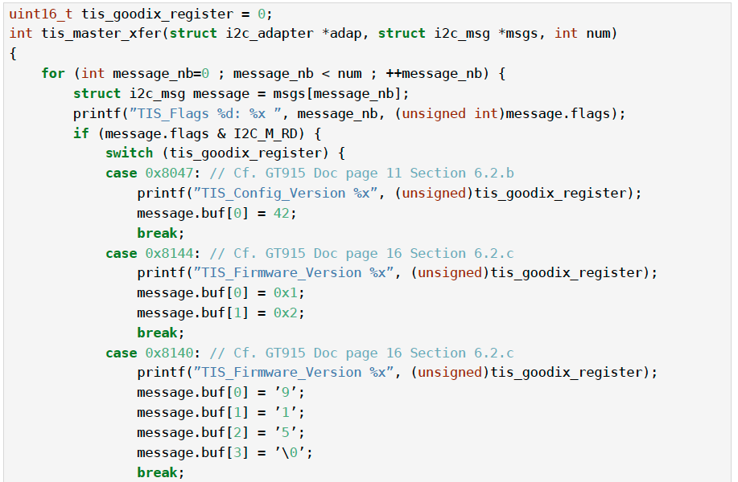

Slide 24
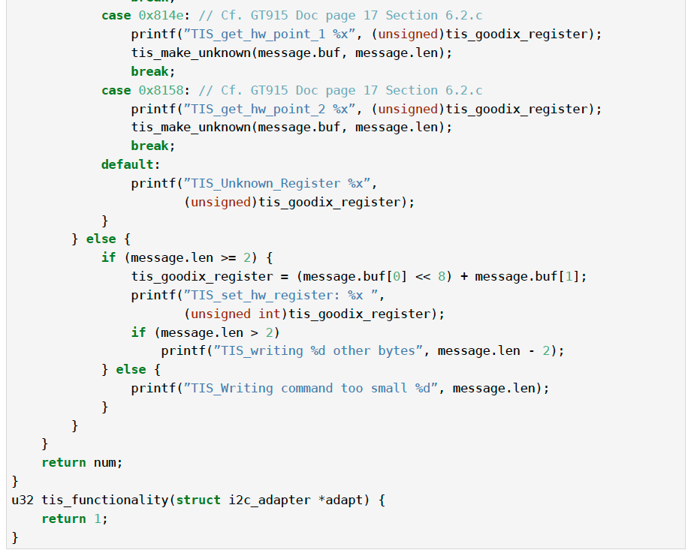
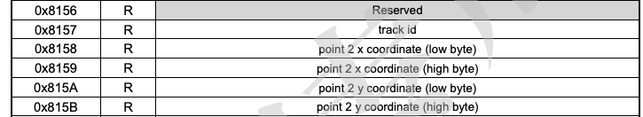

Slide 25
Kernel Modeling – by TrustInSoft
Kernel Level Stubs
Kernel mutex
Linux input driver
Linux Device
Linux GPIO
IRQ Management
I2C Kernel Simulation
Kernel Memory Management
Kernel Timer Management
Device Tree

Slide 26
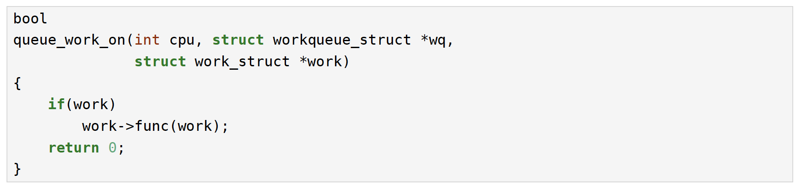
Kernel Modeling Kernel Level Stubs (1/2)
Basic Kernel work queues are modeled. Only one element in the queue needs to be handled.

Slide 27
Kernel Modeling Kernel Level Stubs (2/2)
List of modeled functions:
bool queue_work_on(int cpu,
struct workqueue_struct *wq,
struct work_struct *work)
struct workqueue_struct *
__alloc_workqueue_key(const char *fmt, unsigned int flags, int max_active,
struct lock_class_key *key, const char *lock_name, ...)
bool cancel_work_sync(struct work_struct *work)
void flush_workqueue();
void destroy_workqueue();

Slide 28
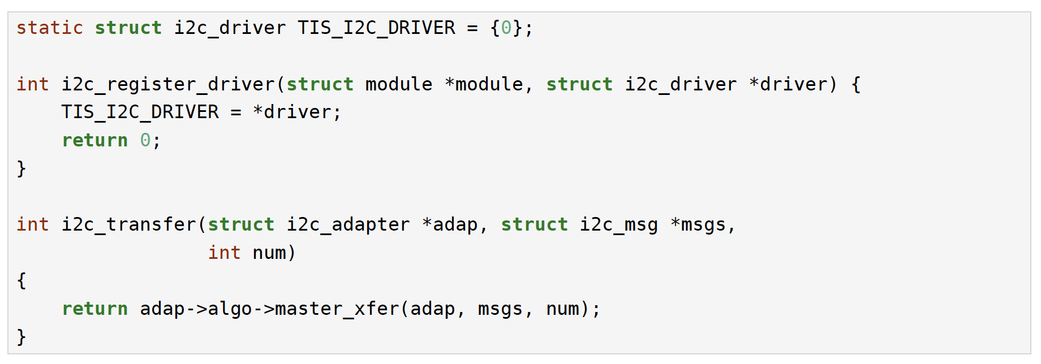
Kernel Modeling I2C Kernel Simulation
The I2C Kernel transfer function is modeled to call directly the GT9xx transfer function.

Slide 30
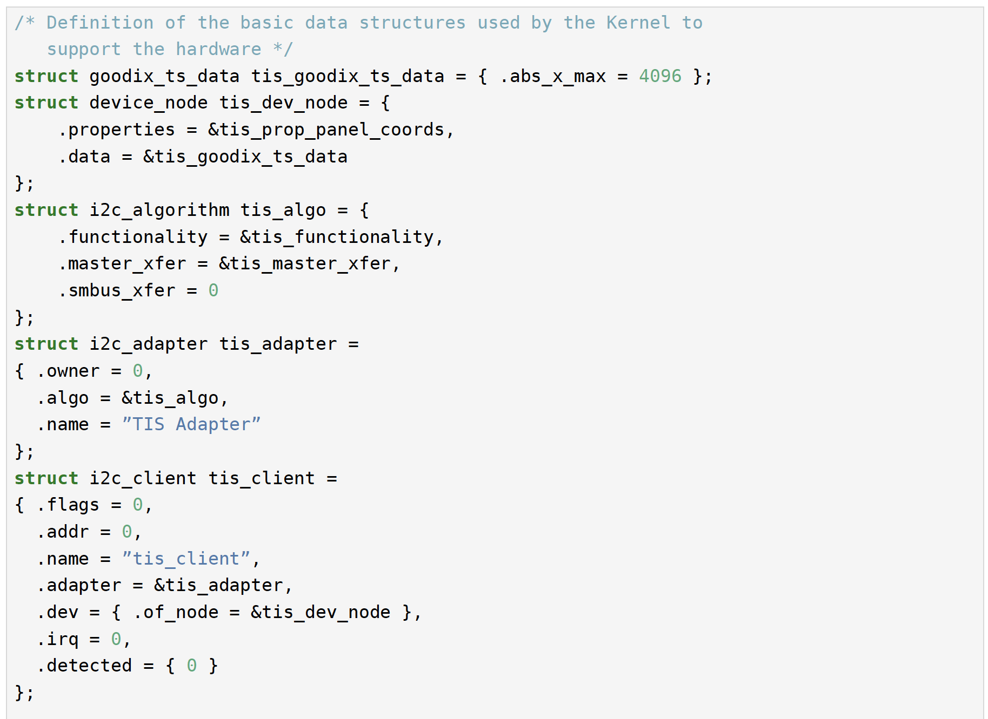
Test model (1/2) : Hw data structures

Slide 31
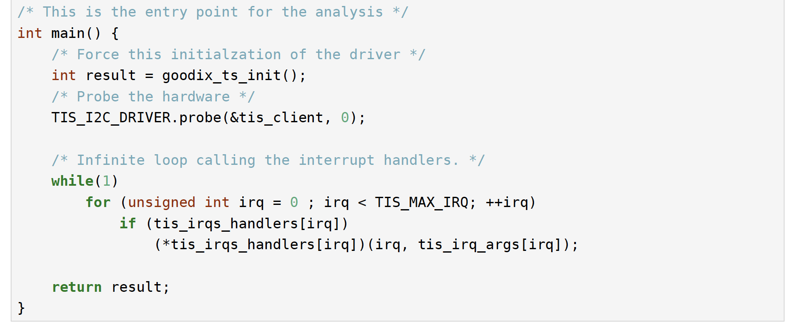
Test model (2/2) : scenario

Slide 32
Yet another test scenario Any order for IRQs
/* This is the entry point for the analysis */
int main() {
/* Force this initialzation of the driver */
int result = goodix_ts_init();
/* Probe the hardware */
TIS_I2C_DRIVER.probe(&tis_client, 0);
/* Infinite loop calling the interrupt handlers. */
while(1) {
int irq = tis_interval(0, TIS_MAX_IRQ);
if (tis_irqs_handlers[irq])
(*tis_irqs_handlers[irq])(irq, tis_irq_args[irq]);
}
return result;
}

